Slide 1

Digital Certificates

Slide 2
Basic Terms
Public Key Cryptographic Standards, PKCS
A collection of 12 papers PKCS #1 to PKCS #12 developed by RSA Labs and representatives from the academia and industry.
PKCS #1 RSA Algorithm
PKCS #3 Diffie-Hellman Algorithm
PKCS #7 Cryptographic Message Syntax Std
PKCS #10 Key Certification Request
PKCS #11 Standard API for developers
PKCS #12 Certificate Interchange Format
PKCS #13 Elliptic Curves Algorithm

Slide 3
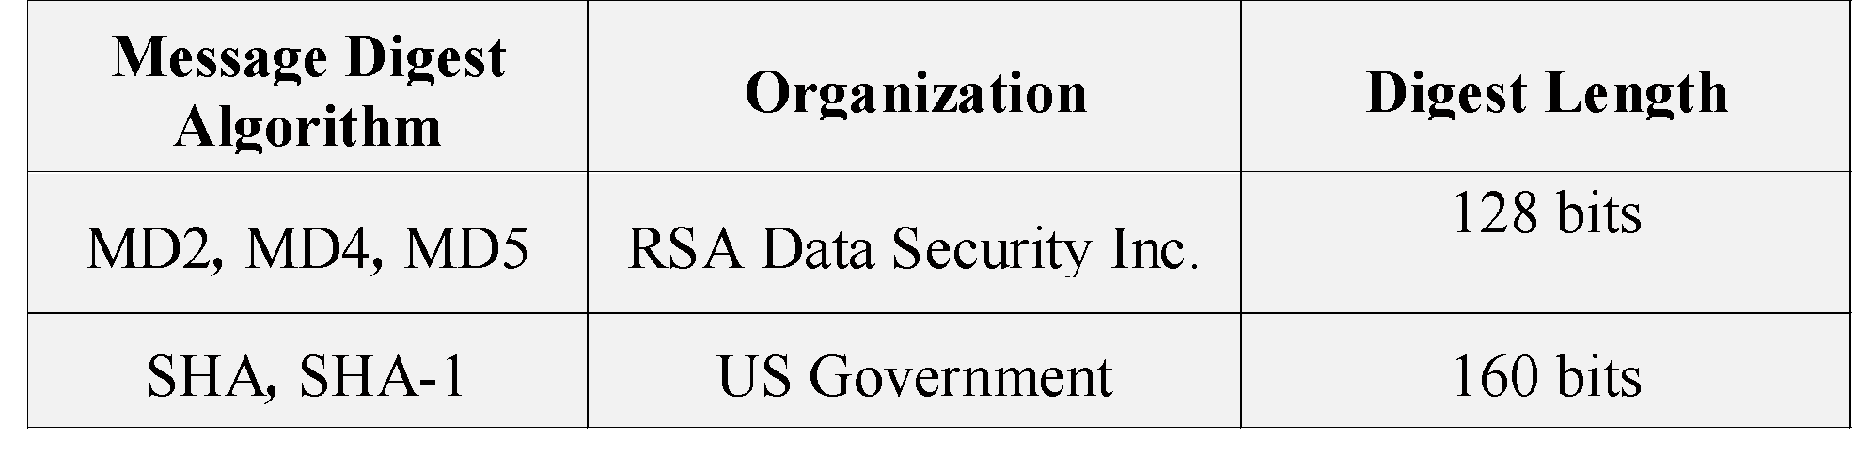
Basic Terms
Digital Signatures
DSS issued by NIST
Message Digest Algorithms
Non Reversible (One way function)
Examples

Slide 4
Digital Certificates
Certificates are the framework for identification information, and bind identities with public keys.
They provide a foundation for
identification ,
authentication and
non-repudiation.

Slide 5
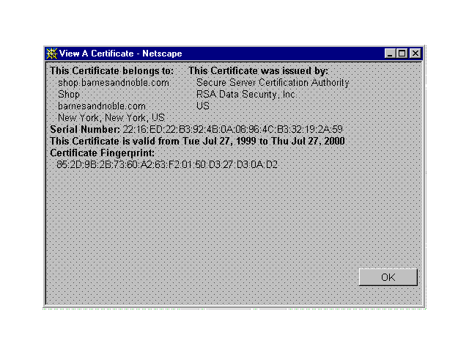
Sample View of a Certificate
Certificate Types :
Private/Personal Server Developer
Notes:
The certificate has a link to the BN site incase you would want to show the actual certificate.
Types
Private: E-mail and for Website access
Server: By big ecommerce sites to protect their web servers and for communication purposes.
Developer: For code signing purposes

Slide 6
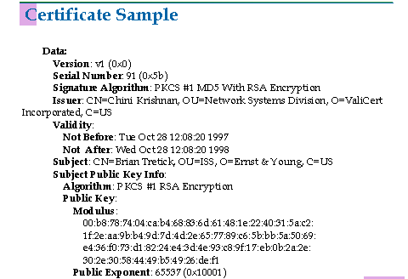
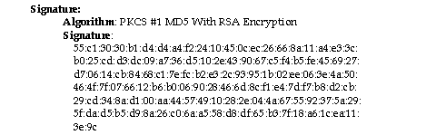

Slide 7
X.509 v3 Certificate Format
Version
Certificate Serial Number
Signature Algorithm Identifier
Issuer Name
Validity Period
Subject Name
Subject Public Key Information
Optional Fields

Slide 8
How Digital Certificates work?
Generate Public and Private Keys.
Get Certificate from the CA
Sign the document/page using the private key.
Send signed document over open networks along with the CA’s certificate.
Recipient verifies using the signing CA’s public key
Trust Chain and Fingerprints
Notes:
http://wwwinfo.cern.ch/support/java/docs/javatutorial/security1.2/sigcert/
Digital Signatures
The basic idea in the use of digital signatures is the following:
1.You "sign" the document or code using one of your private keys
(which you can generate using keytool or security API methods).
That is, you generate a digital signature for the document or code,
using the jarsigner tool or API methods.
2.You send the other person (the "receiver") the document or code
and the signature.
3.You also supply the receiver the public key corresponding to the
private key used to generate the signature, if they don't already
have it.
4.Using the public key, the receiver can verify the authenticity of the
signature and the integrity of the document/code.
Actually, a receiver needs to ensure the public key itself is authentic
before they can reliably use it to check the signature's authenticity. It is
more typical to supply a certificate containing the public key rather than
just the public key itself, as discussed in the next section.
Certificates :
A certificate contains
a public key.
the "distinguished name" information of the entity (person,
company, etc.) whose certificate it is. This entity is referred to as
the certificate subject or owner. The distinguished name
information includes the following attributes (or a subset): the
entity's name, organizational unit, organization, city or locality, state
or province, and country code.
a digital signature. A certificate is signed by one entity (the issuer)
to vouch for the fact that the enclosed public key is the actual
public key of another entity (the owner).
the "distinguished name" information for the signer (issuer).
One way for a recipient to check whether a certificate is valid is by
verifying its digital signature using its issuer's (signer's) public key. That
key may itself be stored in another certificate whose signature can be
verified using the public key of that other certificate's issuer, and that key
may also be stored in yet another certificate, and so on; you can stop
checking when you reach a public key that you already trust and use it to
verify the signature on the corresponding certificate.
If the recipient cannot establish such a trust chain (for example, because
the required issuer certificates are not available), the certificate
fingerprint(s) can be calculated (for example, as may be done by the
keytool -import or -printcert command). Each fingerprint is a
relatively short number that uniquely and reliably identifies the certificate.
(Technically, it's a hash value of the certificate information, using a
message digest function.) The recipient can call up the certificate owner
and compare the fingerprints of the received certificate with those of the
certificate that was sent. If the fingerprints are the same, the certificates
are the same.
Thus, you can ensure that a certificate was not modified in transit. One
other potential uncertainty when working with certificates is the identity of the sender.
Sometimes a certificate is self-signed, that is, signed using the private key
corresponding to the public key in the certificate; the issuer is the same as the subject.
This is ok if the receiver already knows and trusts the sender.
Otherwise, the sender needs to obtain a certificate from a trusted third
party, referred to as a Certification Authority (CA). To do so, you send a
self-signed Certificate Signing Request (CSR) to the CA. The CA verifies
the signature on the CSR and your identity (for example, by checking
your driver's license or other information). The CA then vouches for you
being the owner of the public key by issuing a certificate and signing it
with its own (the CA's) private key. Anybody who trusts the issuing CA's
public key can now verify the signature on the certificate. In many cases,
the issuing CA itself may have a certificate from a CA higher up in the CA
hierarchy, leading to certificate chains.
Certificates of entities you trust are typically imported into your keystore
as "trusted certificates." The public key in each such certificate may
then be used to verify signatures generated using the corresponding
private key. Such verifications can be done by
the jarsigner tool (if the document/code and signature appear in
a JAR file),
API methods, or
the runtime system, when a resource access is attempted and a
policy file specifies that the resource access is allowed for the code
attempting the access if its signature is authentic. The code's class
file(s) and signature must be in a JAR file.
If you are sending signed code or documents to others, you need to
supply them the certificate containing the public key corresponding to the
private key used to sign the code/document. The keytool -export
command or API methods can export your certificate from your keystore
to a file, which can then be sent to anyone needing it. A person that
receives the certificate can import it into their keystore as a trusted
certificate, for example, using API methods or the keytool -import
command.
If you use the jarsigner tool to generate a signature for a JAR file, the
tool retrieves your certificate and its supporting certificate chain from your
keystore and stores them, along with the signature, in the JAR file.

Slide 9
Web Server Security
Server Authentication using SSL
Information to/from the correct Web Site
Information in encrypted form
Setting up SSL on a Web Site
Create a Server Certificate Request
Obtain the Server Certificate from a CA/locally
Install it on the Web Server
Establishing an SSL connection
Need root certificate of the issuing CA
Notes:
Authentication:
Server authentication means a web client need to be sure that it is communicating with a correct web site.Web Servers and Browsers provide this service by using the SSL protocol.
To use SSL we need to get a Server Certificate and install it on the Web Server.When communicating with a site using https:// we are using the SSL. The browser executes a server authentication protocol to make sure it is communicating with the correct site.
SSL establishes secure connections between two TCP protocols. (Accessing https urls causes SSL security to be invoked at both the client and the server end. SSL handshake is then performed to exchange cryptographically protected messages that establish security for the session.
Setting up SSL:
All the three steps are performed by the browsers using the tool such as Key Manager.
CertReq program can be used to generate a certificate locally. (If you are getting a free trial version of the server certificate you will also need to get the CA(signer’s) certificate. This is different from the global root certificate.
Installing a server certificate on a Web Site can again be done using tool provided by various vendors
Enabling SSL on a web site:
We need to specify the IP address of this web site and and also specify the SSL port number(default is 443).
We can also specify whether the whole site a directory or some file needs to use secure access.
Establishing an SSL connection:
To authenticate a web site my browser will need the issuing CA’s root certificate. Almost all of these certificates are built into the browsers.

Slide 10
Client Authentication
Anonymous
Basic
Challenge Response (NT)
SSL Client Authentication

Slide 11
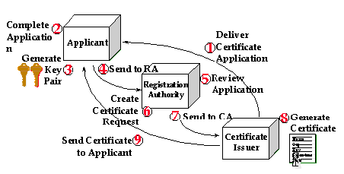
Certification and Registration
Application
Subject Authentication
Certificate Generation
Certificate Distribution
Certificate Revocation

Slide 12
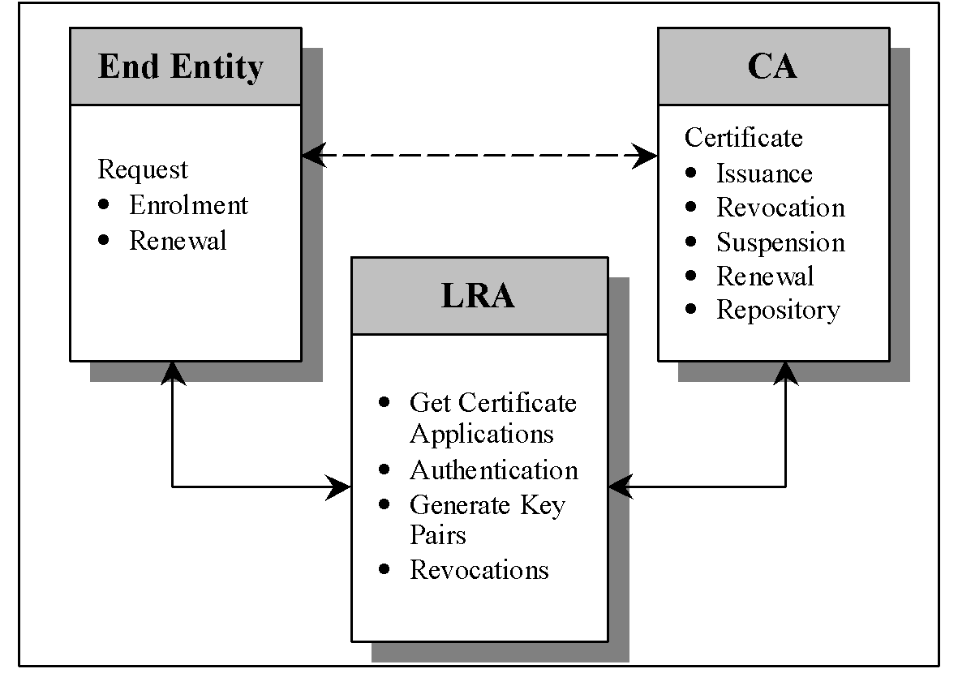
Subject Authentication
Confirm the identity of the subject
Based on the class of certificate
Local Registration Authority(LRA) model
Example : Verisign Onsite

Slide 13
Importing a Certificate
To send an encrypted message or document to a person who has a certificate.
From a Certification Authority
From a Directory Service (LDAP)
From a signed message
From a local file (encoded Binary PKCS #7)

Slide 14

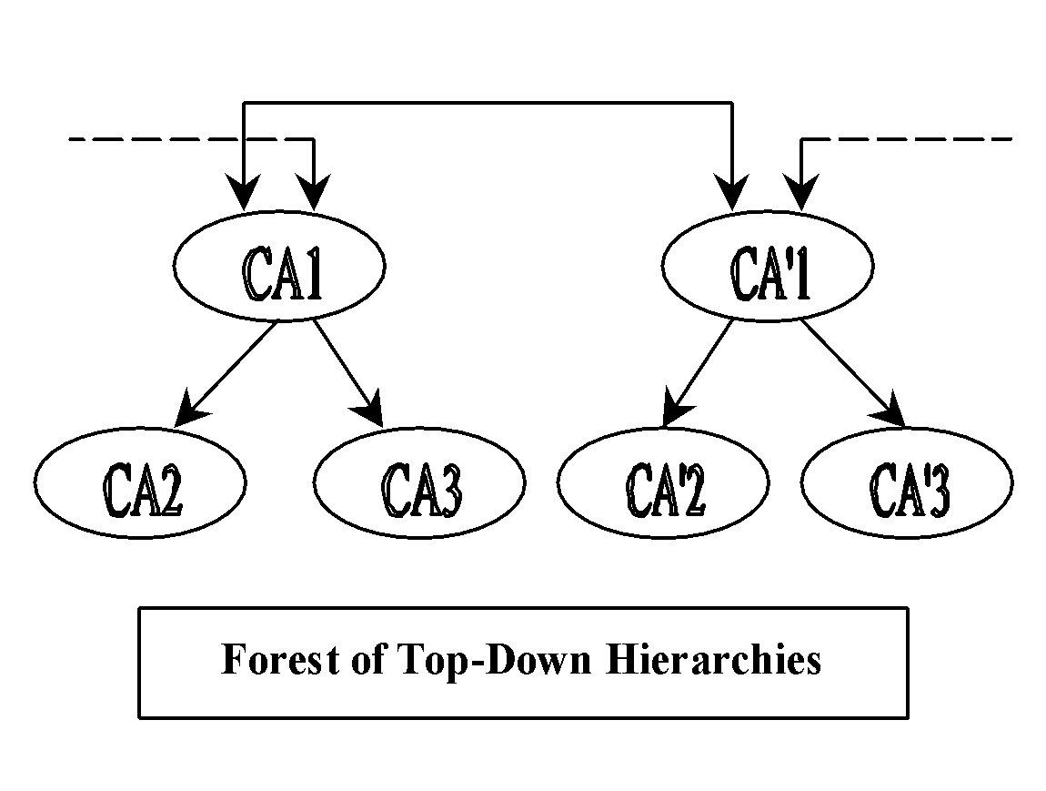
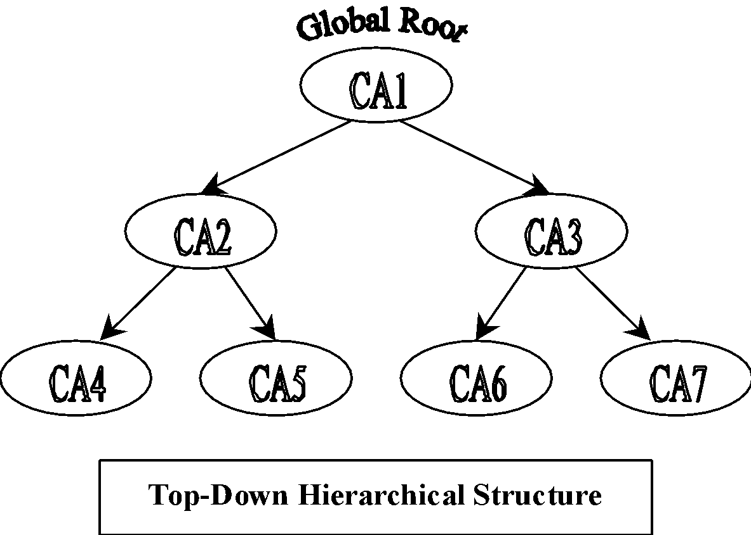
Certificate Management
Value and Validity of Certificates will be questioned
Cross Certification (Multiple CA’s)

Slide 15
Thank You

